Slide 1

Customers’ behavior on credit cards 💳
Data Analysis from Zero to Hero
* Class: DA_241231
* Lecturers: Ms. Thao Vo & Mr. Cuong
* Student: Tran Hoai Anh Tuan
* Contact: thntuan@gmail.com – 0933777865

Slide 2

Customers’ behavior on credit cards 💳
Table of Contents
Introduction
Dataset Description
Methodology and Goals
Dashboard Screenshot
Results Overview
Cluster Analysis
Recommendations

Slide 3
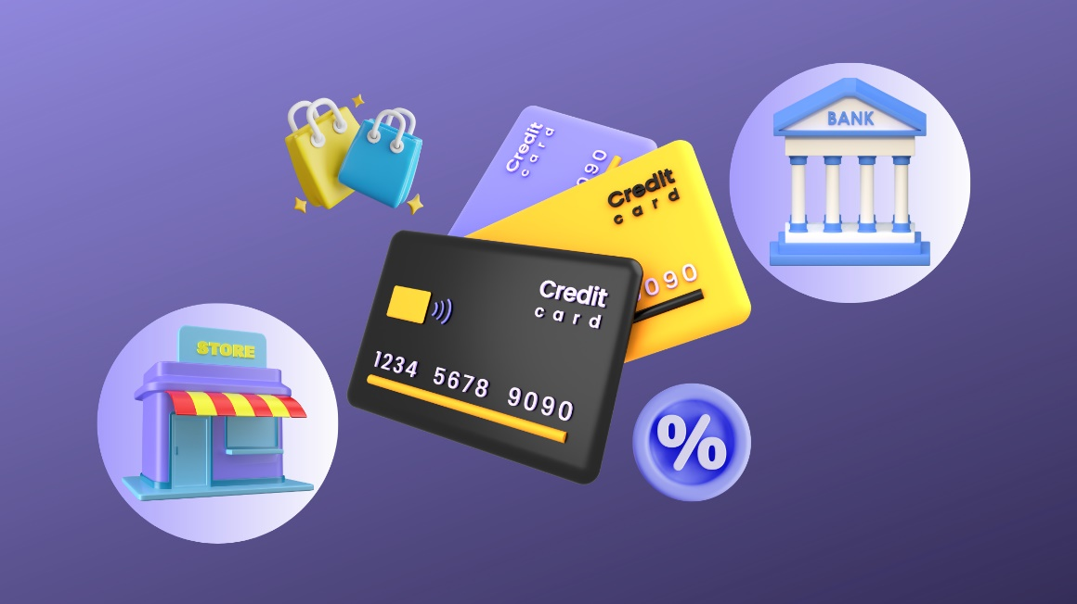
Customers’ behavior on credit cards 💳
Introduction
Credit card plays important roles: Shaping consumer behavior Offering convenience Access to credit Spending opportunities.
However, understanding how different customer groups use credit cards is essential for financial institutions aiming to optimize profitability while minimizing risk.

Slide 4
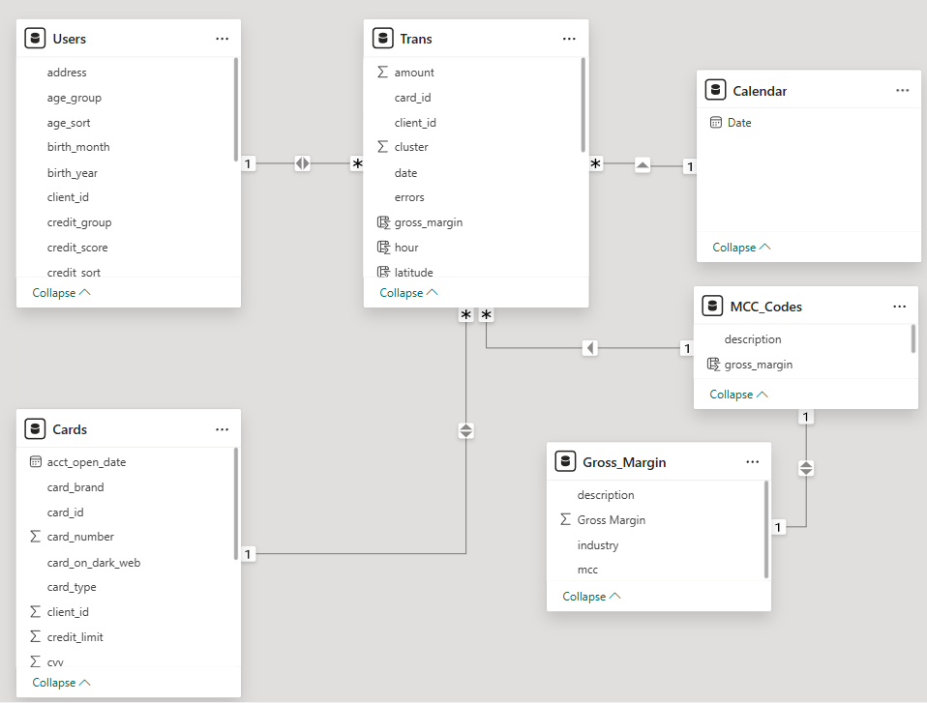
Customers’ behavior on credit cards 💳
Dataset
Description
📂 Transactions: 1M+ rows (amounts, timestamps, merchants)
👤 Users: 6K+ rows (demographics, accounts)
💳 Cards: 2K rows (limits, types, activation)
🏷️ MCC Codes: 109 rows (merchant classification)
📅 Calendar + 📅 Gross Margin: (for reference)

Slide 5

Customers’ behavior on credit cards 💳
Methodology & Goals
Main Goals
🎯 Identify customer groups with highest value
♻️ Strengthen retention strategies
👥 Analyze demographics & spending behavior
Methodology
🧹 Data Cleaning → format & filter
📊 Exploratory Data Analysis → spending trends
🔗 Clustering → K-Means segmentation
🖼 Visualization → Power BI dashboards

Slide 6
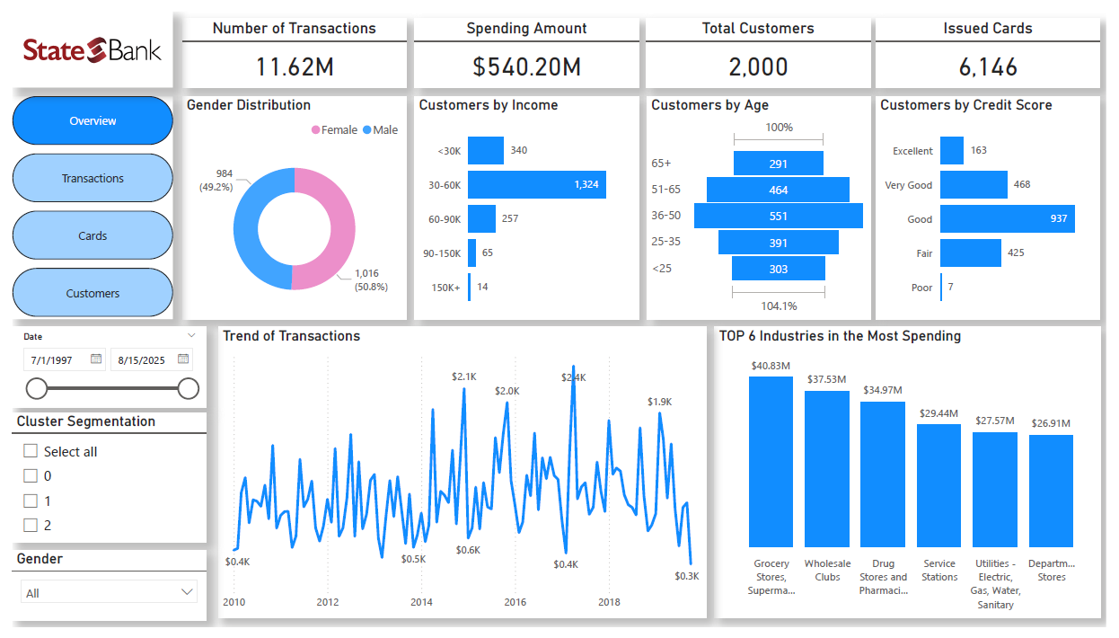
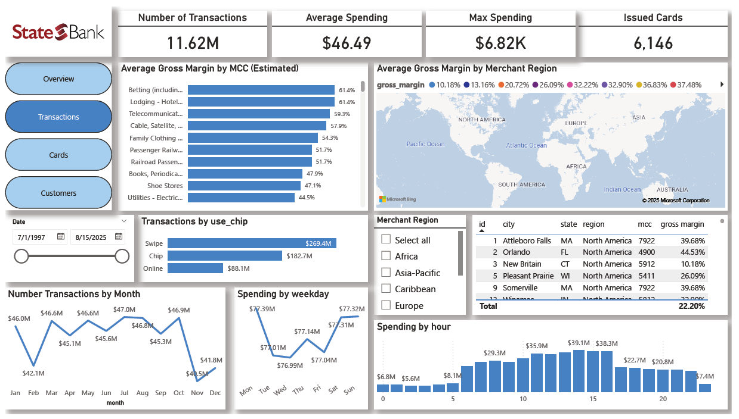
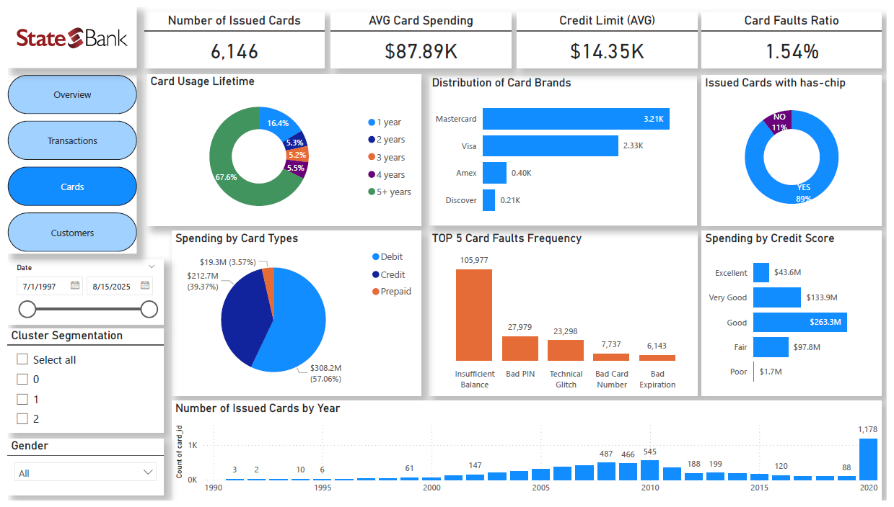
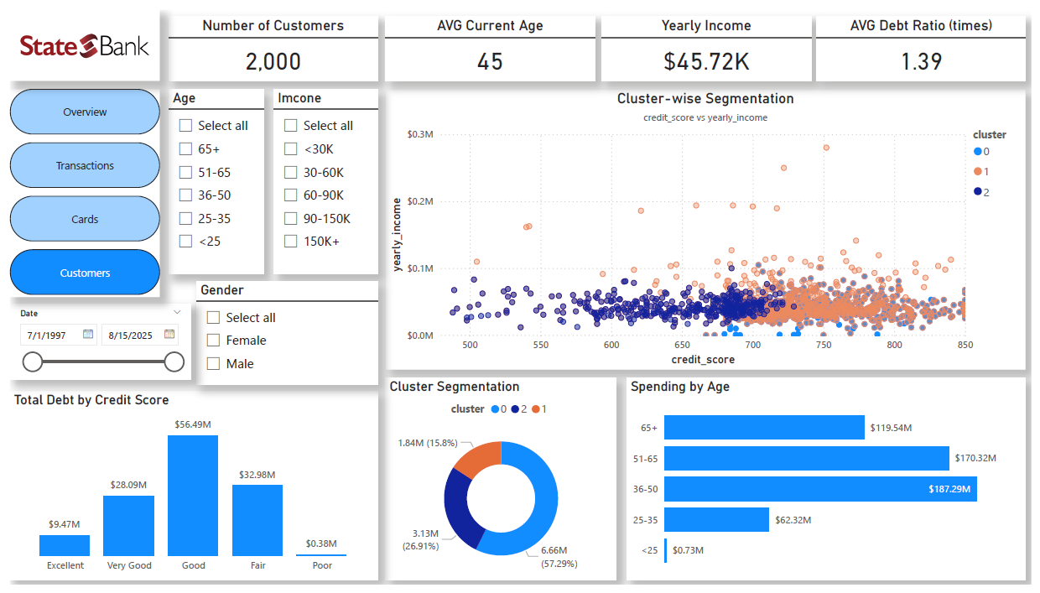
Customers’ behavior on credit cards 💳
Dashboard Screenshots

Slide 7
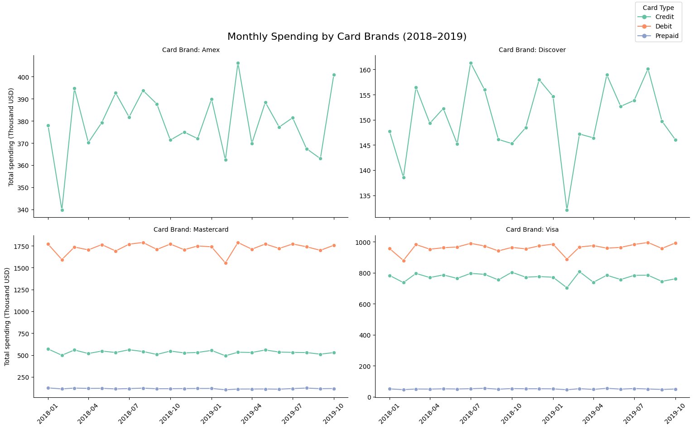
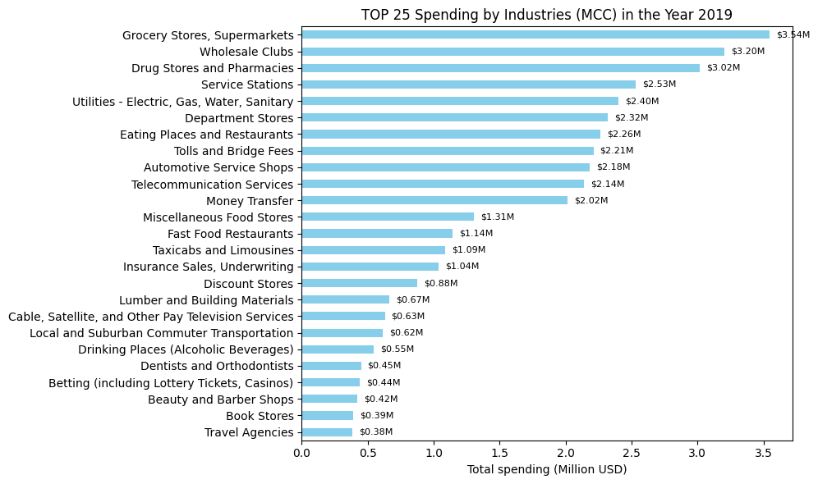
Customers’ behavior on credit cards 💳
Results Overview
💳 Spending by Cards → Mastercard/Visa dominate
🛍 Spending by MCC → Grocery, Wholesale, Pharmacies

Slide 8
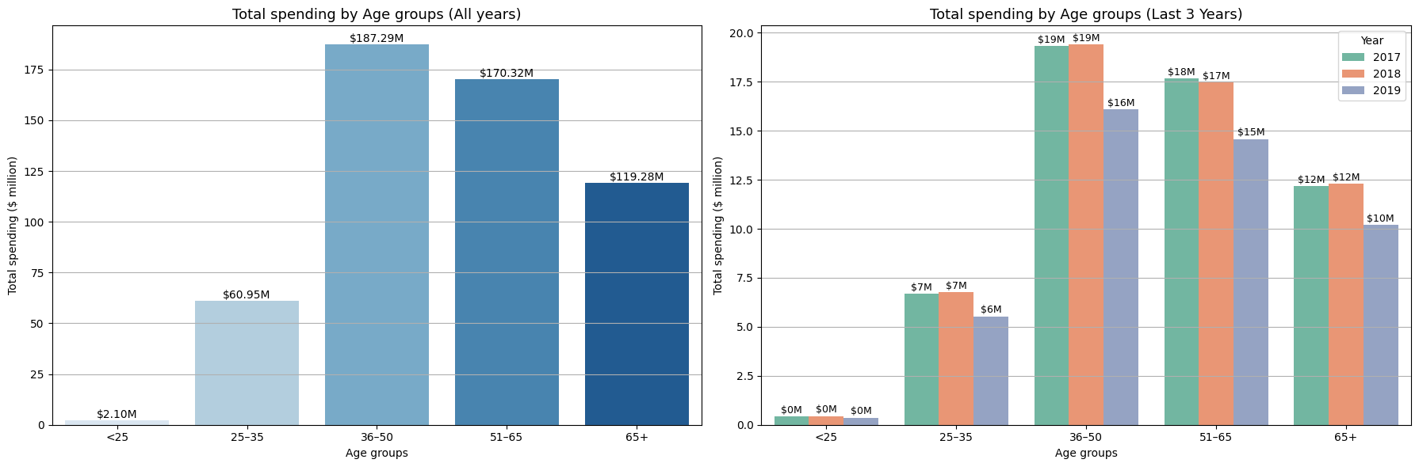
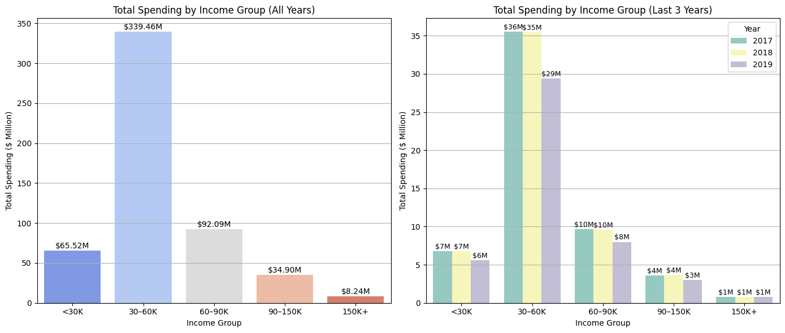
Customers’ behavior on credit cards 💳
Results Overview
👥 Demographics → Age 36–50 highest spend
🛍 Spending by MCC → Grocery, Wholesale, Pharmacies

Slide 9
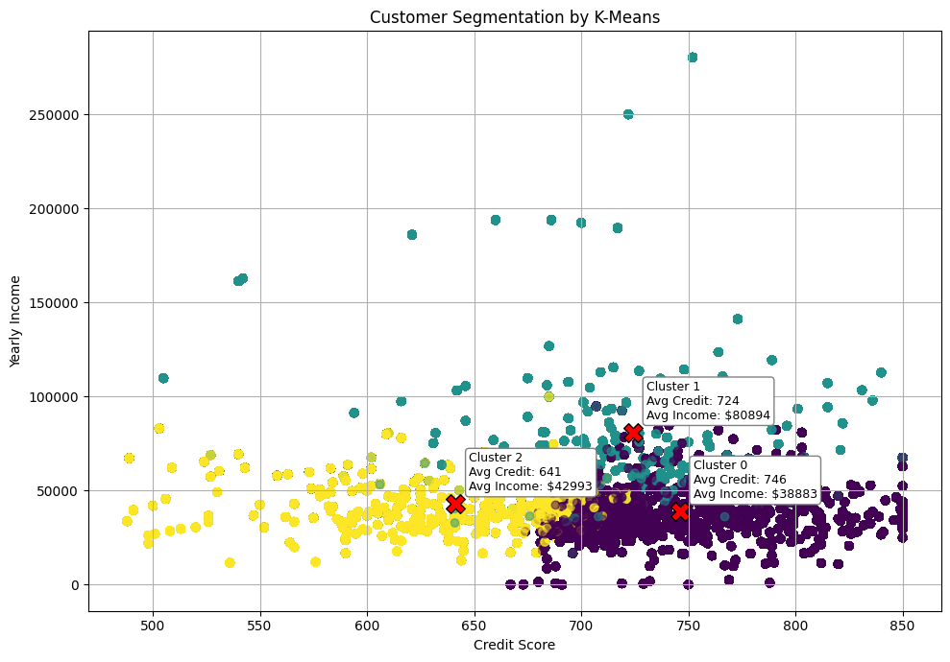
Customers’ behavior on credit cards 💳
Cluster Analysis
🟣 Cluster 0 — Stable Low-Income
- High credit score, low income
- Conservative, loyal customers
🟢 Cluster 1 — Prime Customers
- High income (~$81K), solid credit
- Professionals, frequent travelers
🟡 Cluster 2 — At-Risk/Emerging
- Low score, moderate income
- Financially unstable, higher risk

Slide 10
Customers’ behavior on credit cards 💳
Recommendations
🟣 Cluster 0 — Stable Low-Income
Small limit increases
Fee waivers
Essentials cashback
🟢 Cluster 1 — Prime Customers
Travel rewards
Concierge
Cross-sell wealth products
🟡 Cluster 2 — “At-Risk” Customers
Secured cards
Financial education
Repayment incentives

Slide 11

Customers’ behavior on credit cards 💳

